Slide 1
Project - update
Samuel prabhakar

Slide 2
Braess Paradox
In some cases, adding edges can decrease efficiency.
Under the assumption that every participant in the network is selfish.

Slide 3
Graph Spectrum
Initially a directed weighted scale free network is generated.
Hubs (popular nodes) are taken from that graph.
Now a directed, weighted path graph is generated.
Edges are added on probability, where the power hubs from initial scale free network has a higher chance of getting a edge added to them.
Even though all edges are directed, they are unidirectional
The example, of graph growing.

Slide 4
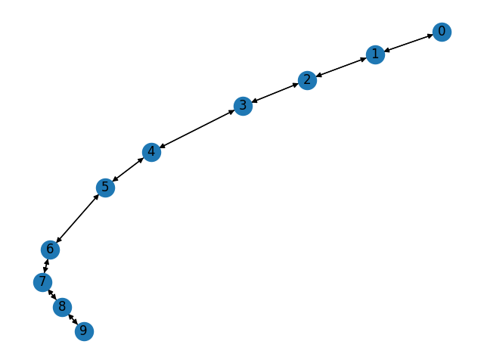
Series 1

Slide 5
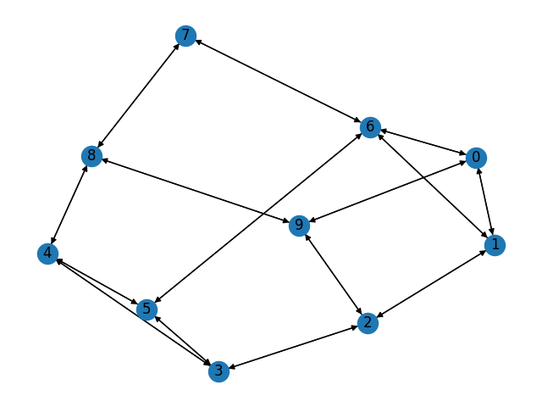
Series 2

Slide 6
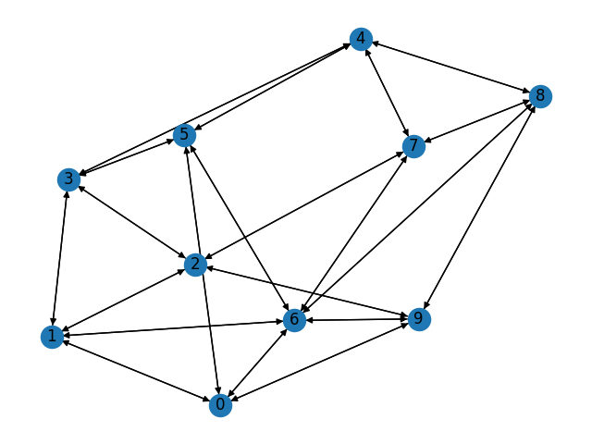
Series 3

Slide 7
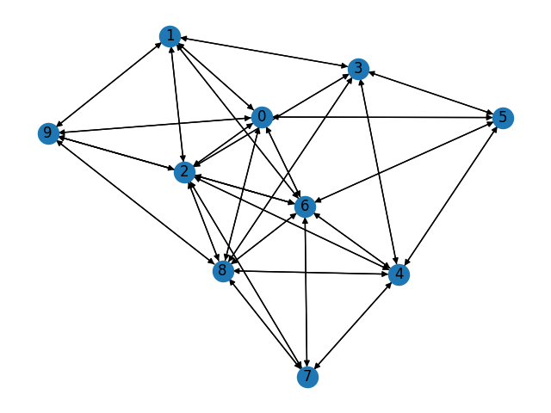
Series 4

Slide 8
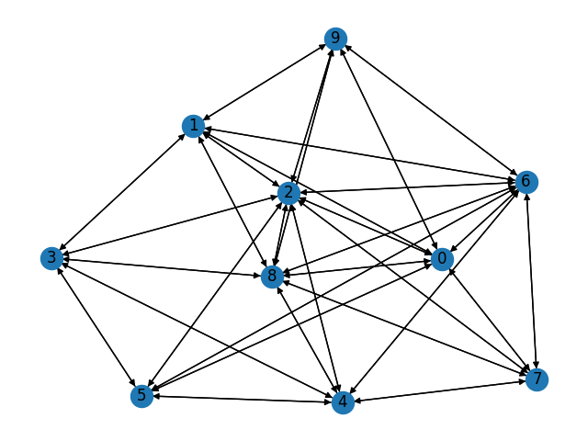
Series 5

Slide 9
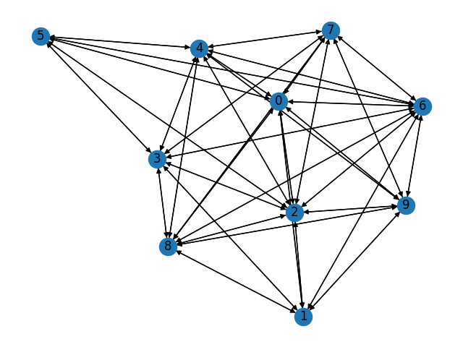
Series 6

Slide 10
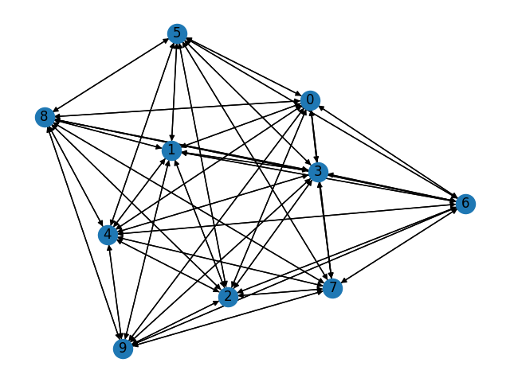
Series 7

Slide 11
Modeling selfish behavior
Used linear threshold to model selfish behavior
Every bots have a threshold value, they are in a network themselves. This models human connection to each other, such as friends of friends. And models human interaction.
Every bot has a threshold value, every connection has a weight attached to it.
If incoming influences are more than the threshold value, then they get affected and began to switch their path to shortest path.

Slide 12
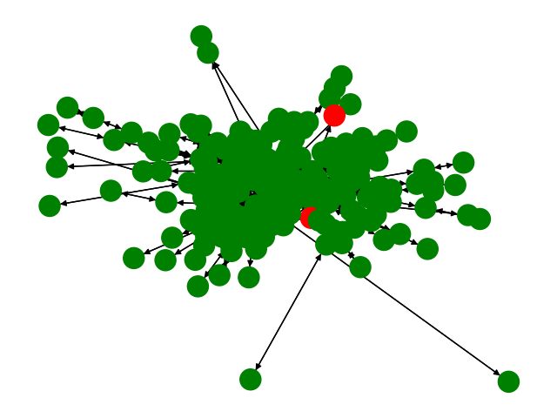
Series 1

Slide 13
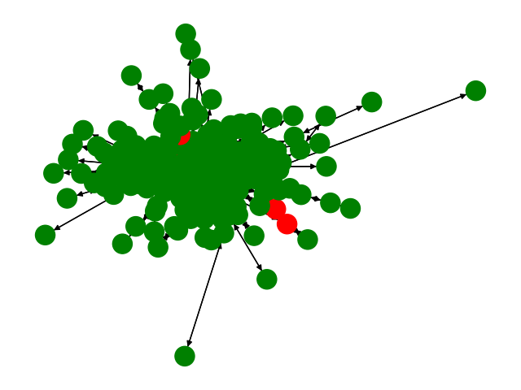
Series 2

Slide 14
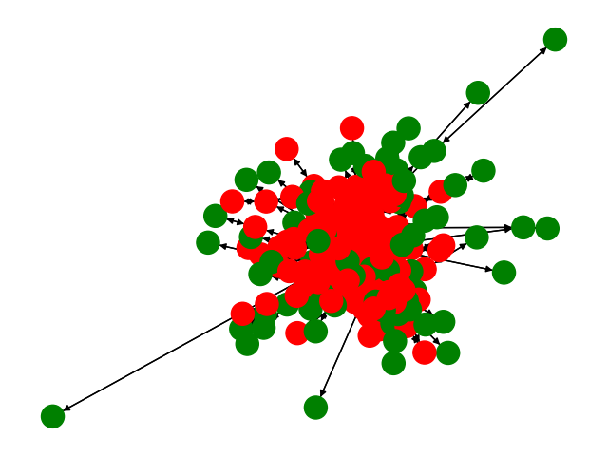
Series 3

Slide 15
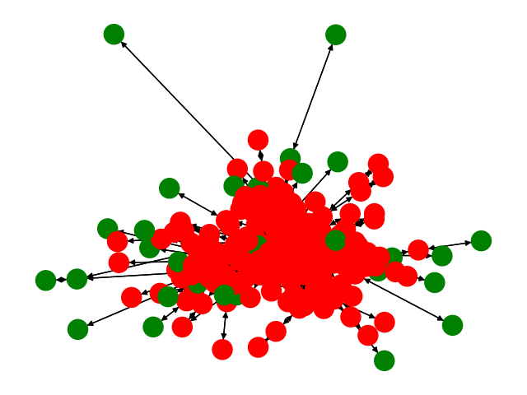
Series 4

Slide 16
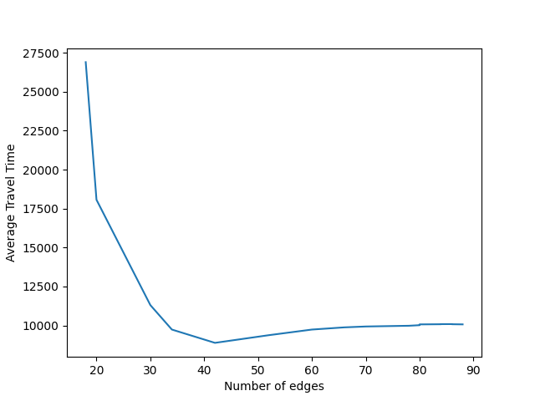
Detection of Braess Paradox, Results

Slide 17
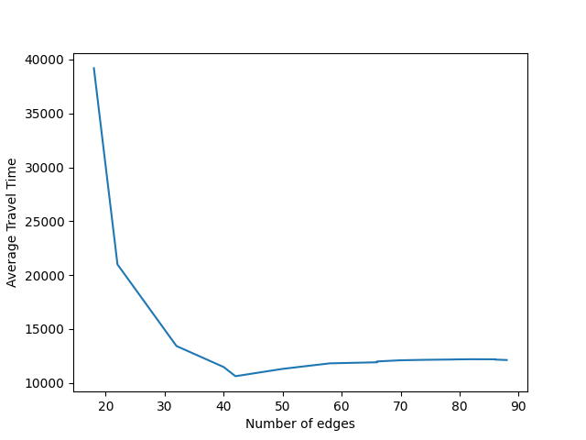
Simulation 2

Slide 18
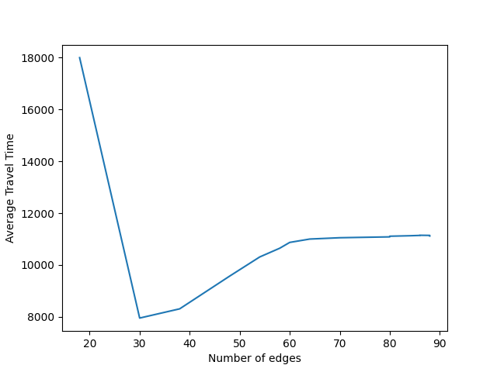
Simulation 3

Slide 19
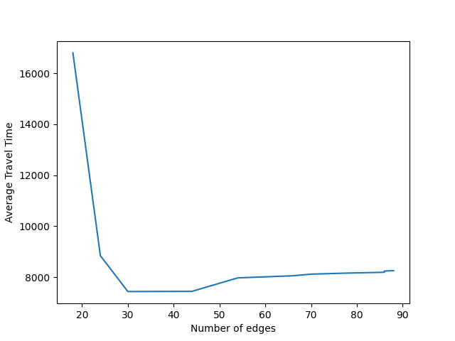
Simulation 4

Slide 20
Simulation 5

Slide 21
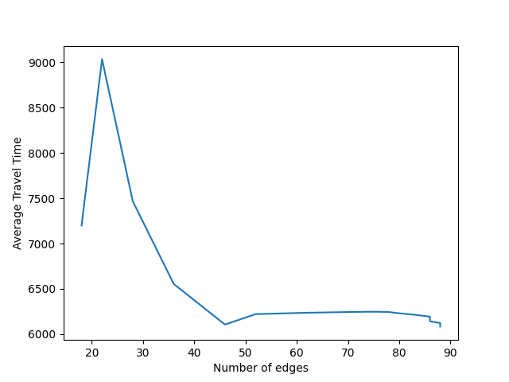
Braess Paradox

Slide 22
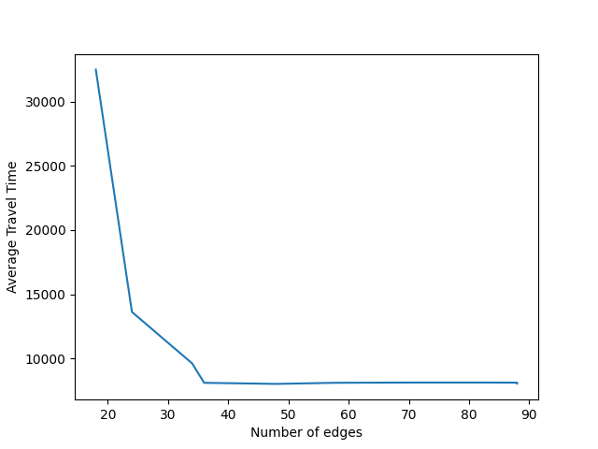
Non Braess Paradox

